Slide 1

Supplementary Live Session Week 5
MET CS 682
Information Systems
Analysis and Design
Dawson Williams
Last Updated 09/23/23

Slide 2
Agenda
Goals Of Systems Design
Cohesion & Coupling
Packages
Data Flow Diagrams concepts
correct/incorrect data flows, more comparisons between logical & physical DFDs

Slide 3
Goals of System Design
Sufficiency: Handles the requirements
Flexibility: Can be readily modified to handle changes in requirements
Reusability: Can use parts of the design and implementation in other applications: Design Patterns
Robustness: Can deal with a wide variety of correct and incorrect input
Reliability: Acceptable failure rate
Security: Includes components to assure appropriate protection from security threats
Efficiency: Executes within acceptable limits of time, space, and any other applicable resources
Overarching Goals of Object Oriented Design is Low Coupling & High Cohesion
CS682 Module 5

Slide 4
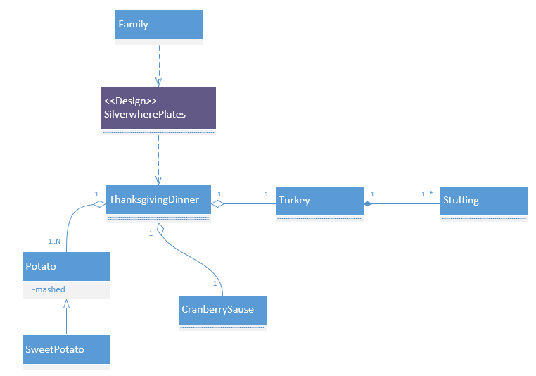
Cohesion & Coupling
Cohesion: Degree to which all of the attributes and behaviors of a single class are related to each other. (Whitten, 2007)
How well within a module do components belong together.
Coupling: Degree to which one class is connected to or relies upon another class. (Whitten, 2007)
How well do modules communicate with each other.
How do the parts fit together effectively within a design?
Maximize Cohesion (like components together)
Minimize Coupling (minimize relationships)

Slide 5
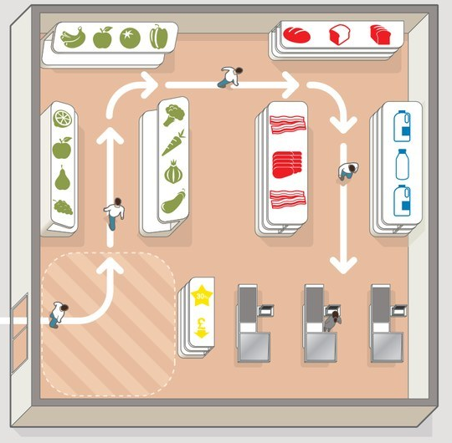
Cohesion & Coupling
Low Coupling
&
High Cohesion
High Coupling
&
Low Cohesion
Shopping List
Milk
Eggs
Ice Cream
Hot Dogs
Paper Towels
Plastic Plates
Juice
Water
Shopping List
Paper Towels
Milk
Hot Dogs
Ice Cream
Juice
Plastic Plates
Eggs
Water

Slide 6
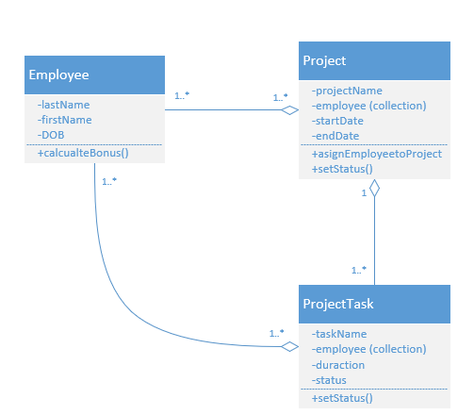
Cohesion & Coupling
Low cohesion increases coupling
High cohesion decreases coupling
Design is a balance between sufficiency, flexibility, reusability realized through cohesion and coupling.
High Coupling

Slide 7
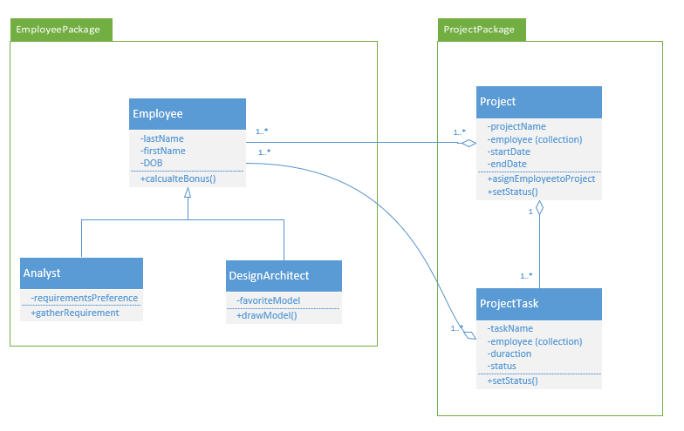
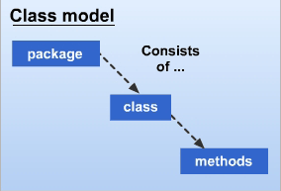
Packages
Package is a set of classes that belong together conceptually.
Class models may be decomposed into packages that decompose into smaller packages which decompose into classes, and these, in turn, decompose primarily into attributes and methods.
The number of packages at each level should be small so that people can comprehend the result.
A range of “7 ± 2” is a useful guideline.
CS682 Module 5

Slide 8
Cohesion & Coupling within Package Design
Having inheritance and composition between packages should be avoided - Look to Aggregation, dependency (low degree of coupling)

Slide 9
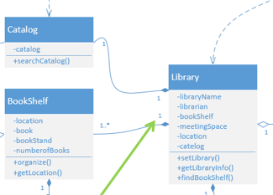
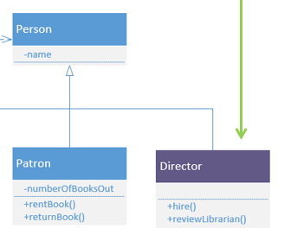
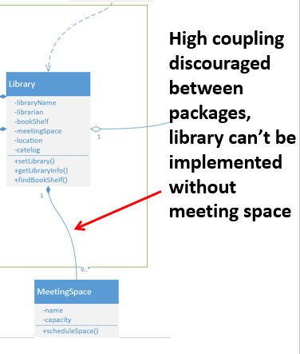
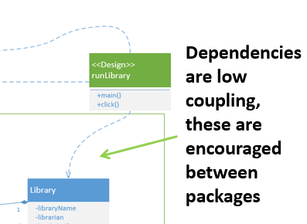
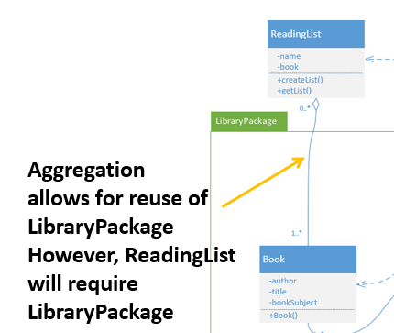
Cohesion & Coupling within Package Design
Within a package – high level of coupling is expected
inheritance and composition display a high level of coupling
Having inheritance and composition between packages should be avoided - Look to Aggregation (keep in mind direction, Dependency (low degree of coupling)

Slide 10
Sufficiency
Sufficiency: Do components & their responsibilities satisfies the systems requirements?
(Validation & Verification)
How do we evaluate Sufficiency?
Decompose the problem down into Parts/Modules
Recursive Design: What are sub-components of those components?
At each step, system decomposition involves consideration of cohesion and coupling
In other words: How do the parts fit together effectively?
Consider building MS office all at once vs each application at a time.

Slide 11
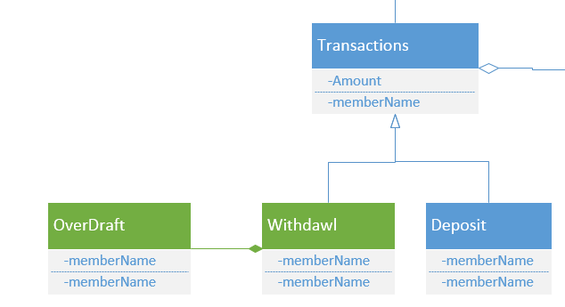
Flexibility & Reusability
Design so that parts of our applications can be reused by others and ourselves on similar or even on different projects.
Adding new kinds of functionality
Example: add withdraw to existing deposit function
Changing functionality
Example: allow withdrawals to create an overdraft
Consider how relationships between classes and packages within your design affect Flexibility & Reusability
Inheritance
Association/Aggregation/Composition
Dependency

Slide 12
Maintainability
Low coupling/high cohesion important for system maintainability
It takes a greater effort to figure out in what class something is implemented in high coupling/low cohesion designs.
Low coupled/high cohesion architectures are easier to modify
Isolating units of functionality we tend to minimize the effects of changes.
Look to balance isolated designs with simplicity (complex inherited structures are harder to maintain)

Slide 13
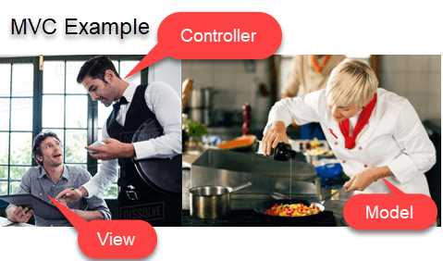
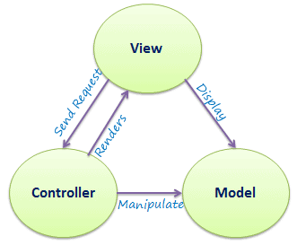
MVC Architecture
One way to increase flexibility and reusability is consider
https://www.tutorialsteacher.com/mvc/mvc-architecture
https://www.guru99.com/mvc-tutorial.html

Slide 14
Efficiency
Efficiency: the use of available machine cycles, memory, communication bandwidth, storage, and other resources.
Create designs and implementations that are as fast as required, and which make use of no more than the required amount processing and energy resources.
Efficient designs are often achieved in stages.
Construct without regard to efficiency
Identify bottlenecks
Original design is modified.
However, if you know methods of avoiding bottlenecks in the first place, try to design with that in mind!
What’s the slowest component of hardware?
How can a design be made to reduce inefficiencies such as in I/O?
How does Low Coupling & High Cohesion effect Efficiency?
Avoiding inefficient code practices

Slide 15
Robustness, Reliability, Usability
Robust design or implementation is able to handle unusual conditions.
Bad data, User errors, Programmer error, Environmental conditions.
Example: Adobe Connect politely tells us that our session has crashed, and brings us right back in without much effort (I wish!)
Robustness is mostly the result of a good design.
Reliable application is relatively defect-free.
Unrealistic to expect that a real-world application be 100% defect-free.
Use Metrics: allowable average time between failures (Quality Non-Functional requirements!).
Reliability is a process-requires thorough inspection and testing (V& V)of artifacts.
Design affects reliability in that a good design that is well understood will make it easier for developers to produce error-free applications.
An application has high usability if users find it easy to use.

Slide 16
Final Word on Goals of System Design….
Overarching Goals of Object-Oriented Design is Low Coupling & High Cohesion.
KISS – Keep it simple!
These goals sometimes contradict one another.
For example, to make a design efficient it may be necessary to combine modules in ways that limit flexibility.
Low/high cohesion & coupling tradeoffs.
We trade off goals against each other in ways that depend on the project's priorities.
For Example: Efficiency to run on low power mobile device over flexibility of running on different screen sizes/OS.

Slide 17
Architecture Process Flow Modeling
Process modeling – a technique used to organize and document a system’s processes. (Whitten, 2007)
Logical Data Flow Diagrams
Physical Data Flow Diagrams
Network Data Flow Diagrams

Slide 18
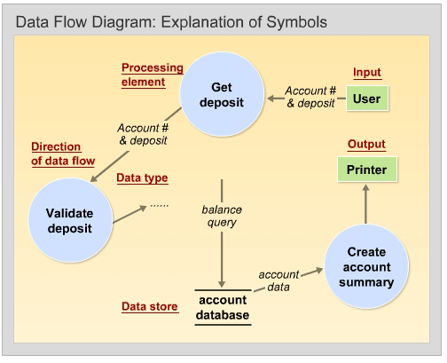
Data Flow Diagrams
Data flow diagram (DFD) – a process model used to depict the flow of data through a system and the work or processing performed by the system. Synonyms are bubble chart, transformation graph, and process model. (Whitten, 2007)
Logical model – a nontechnical pictorial representation that depicts what a system is or does. (Whitten, 2007)
Physical model – a technical pictorial representation that depicts what a system is or does and how the system is implemented. (Whitten, 2007)
Logical model
(You are doing Physical Model on the assignment!)

Slide 19
Logical Model
(You are doing Physical Model on the assignment!)
Physical model – a technical pictorial representation that depicts what a system is or does and how the system is implemented. (Whitten, 2007)

Slide 20

External Agent (Entity)
An outside person, unit, system, or organization that interacts with a system. (Whitten, 2007)
Define the “boundary” or scope of a system being modeled.
Work & activities may occur inside the external agent, but out of scope of what’s being modeled.
As scope changes, external agents can become processes, and vice versa.
Examples:
One of system’s end-users or managers.
Another information system.
Office, department, division, external organization.
Named with descriptive, singular noun
Permissible to duplicate (Whitten 2007), should be at the edges of DFDs and should be minimized.

Slide 21
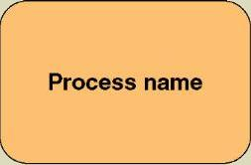
Processes
Work (Transformation of data) performed by a system in response to incoming data flows or conditions. (Whitten, 2007)
Respond to business events and conditions and transform data into useful information.
Inputs, Outputs, Feedback/Control Loops
Modeling processes helps us to understand the interactions with the system's environment, other systems, and other processes.
Named with a strong action verb followed by object clause describing what the work is performed on/for .
Examples (Functions, Events):
Perform Calculations: (Calculate GPA)
Make Decisions: (Determine Availability of ordered product)
Sort, Filter, Organize & Summarize Data (generate report)

Slide 22


Data Stores
Stored data intended for later use. Synonyms are file and database. (Whitten, 2007)
Frequently implemented as a file or database.
A data store is “data at rest” compared to a data flow that is “data in motion.” (Whitten, 2007)
Examples of data stored in Data Stores:
Persons, Places, Objects
Events (about which data is captured)
Concepts (about which data is important)
Data stores depicted on a DFD store all instances of data entities (depicted on an ERD)
Named with plural noun (i.e. Customers)
Permissible to duplicate (Whitten 2007), should be at the edges of DFDs and should be minimized.

Slide 23
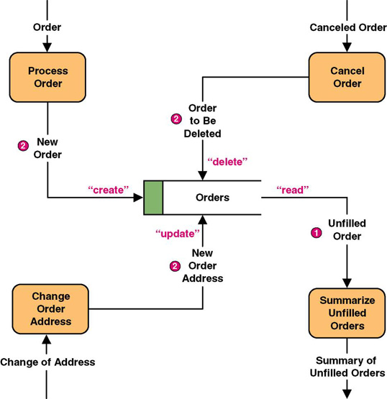
Data Flows
Data that is input to or output from a process. (Whitten, 2007)
A data flow is data in motion
A data flow may also be used to represent the creation, reading, deletion, or updating of data in a file or database
Data flow name
Figure 9-8 P329 (Whitten, 2007)

Slide 24
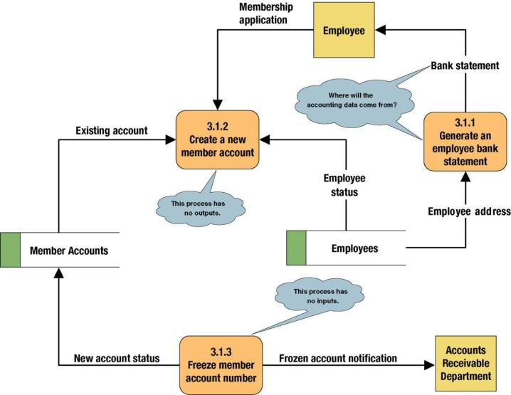
Common Errors on Data Flows
THIS IS EXAMPLE OF
LOGICAL DATA FLOW
Figure 9-5 P326 (Whitten, 2007)

Slide 25
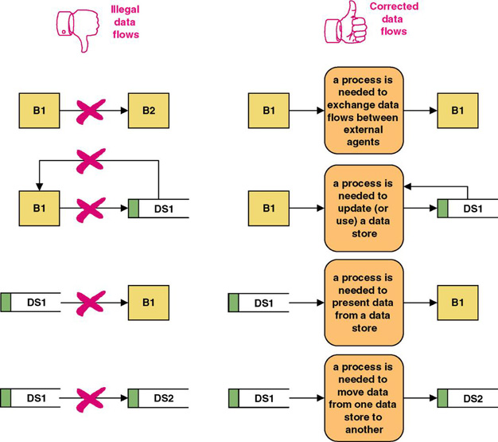
Illegal Data Flows
Figure 9-9 P330 (Whitten, 2007)

Slide 26
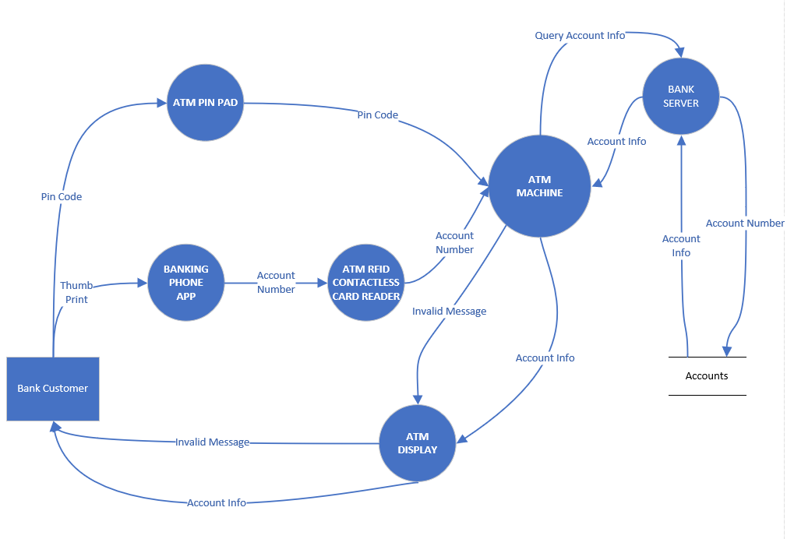
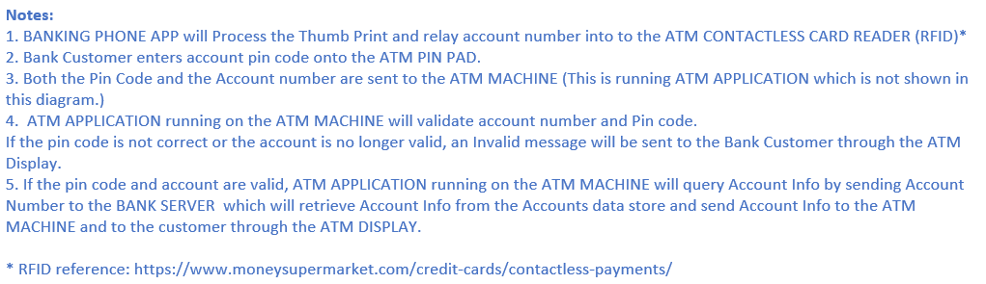
Physical data flow diagram (DFDs) – a process model used to communicate the technical implementation characteristics of an information system. (Whitten, 2007)

Slide 27
Use Case for Playing Music Station
Precondition: Precondition Music App open displaying home screen.
Actors: Listener: Listener Free Listener Paid
Don’t forget alternate steps and pre and post conditions!
Actor | System
1) Listener clicks on Search | 2) System displays search screen
3) Listener types in name of song | 4) System displays suggested search results
5) Listener selects suggested result | 6) System displays matching station, songs, albums and artists.
7) Listener clicks on station | 8) System displays selected station and begins to play
 | 9) System plays song
 | 10) System plays next song
11) Listener stops station | 12) System stops song
13) Listener exits station | 14)System displaying home screen

Slide 28
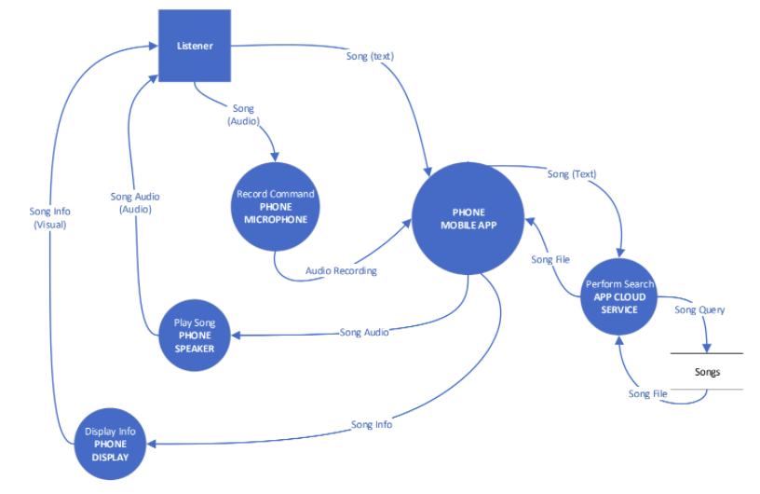
Music App Physical Data Flow

Slide 29
Mobile APP performs several processes:
Listener can request song either through Audio recording through PHONE MICROPHONE or direct
text input into the PHONE MOBILE APP.
PHONE MOBILE APP will then convert Audio Recording to text if needed and send song as text to
the APP CLOUD SERVICE.
The APP CLOUD SERVICE performs the Song Query search against the Songs data store.
The Song file is sent back to the Listener through the PHONE MOBILE APP – it will be displayed on
the PHONE DISPLAY and also be played through the PHONE SPEAKER.
In this design, MICROPHONE, MOBILE APP, SPEAKER and DISPLAY are located on the MOBILE
PHONE. If this was a higher level diagram, these four physical implementations would be combined into one MOBILE PHONE.

Slide 30
Systems Architecture
Client Server
Virtualization
N-Tier
Dedicated Servers
Converged Systems (Blades)
Hyperconverged Systems
Cloud Based Architecture

Slide 31
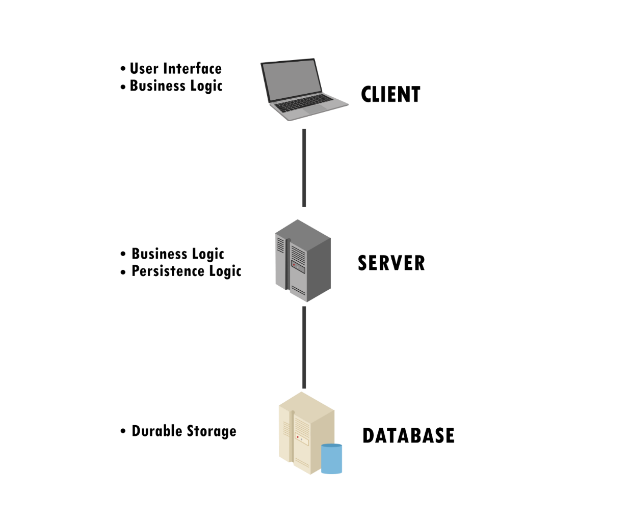
2-tier Client-Server Architecture

Slide 32
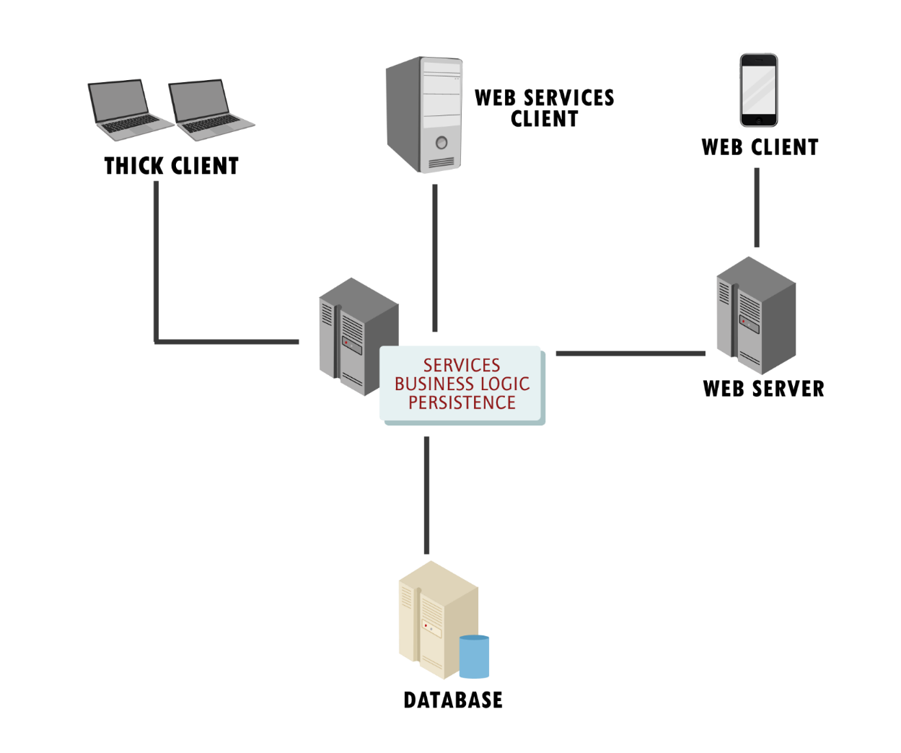
N-Tier Client-Server Architecture

Slide 33
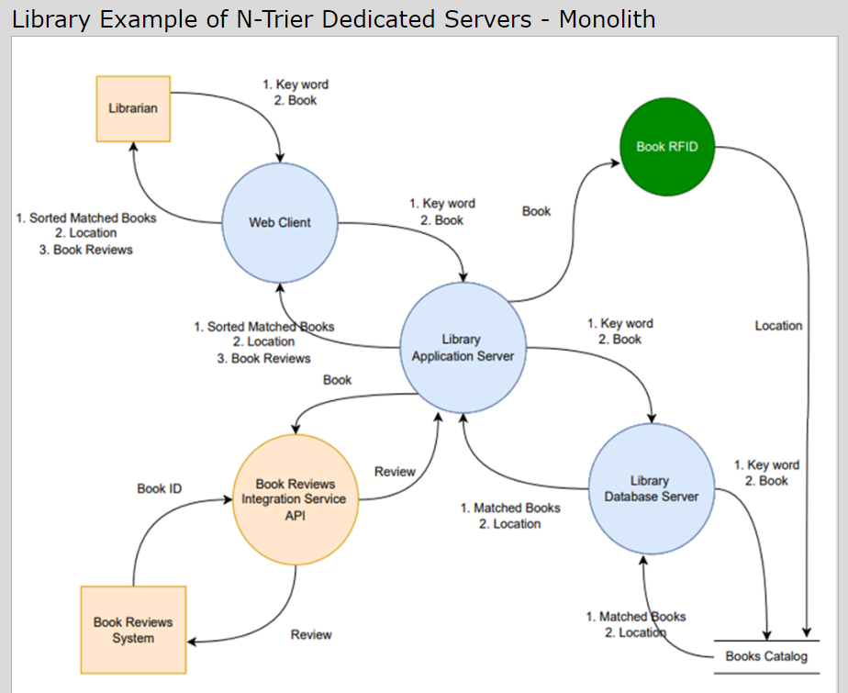
N-Tier Dedicated Servers

Slide 34
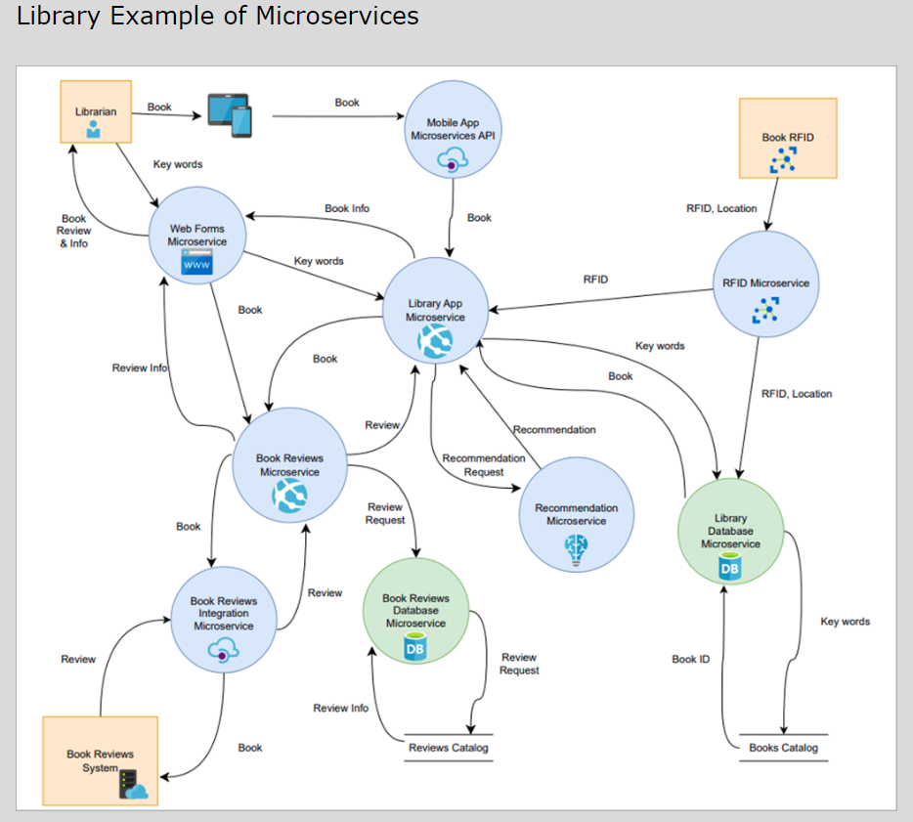
Microservices

Slide 35
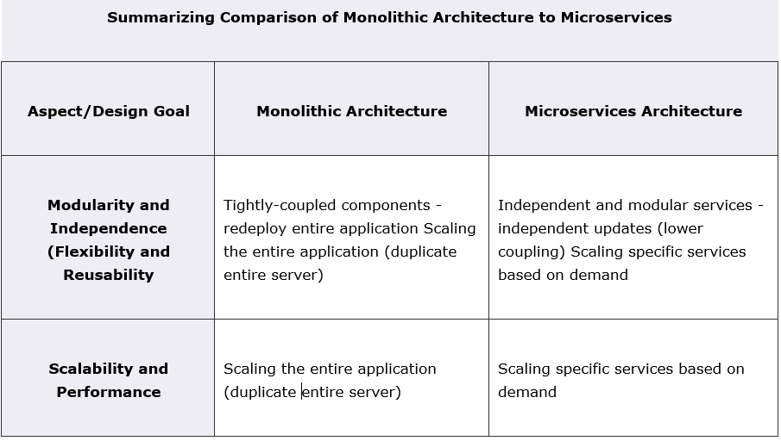

Slide 36
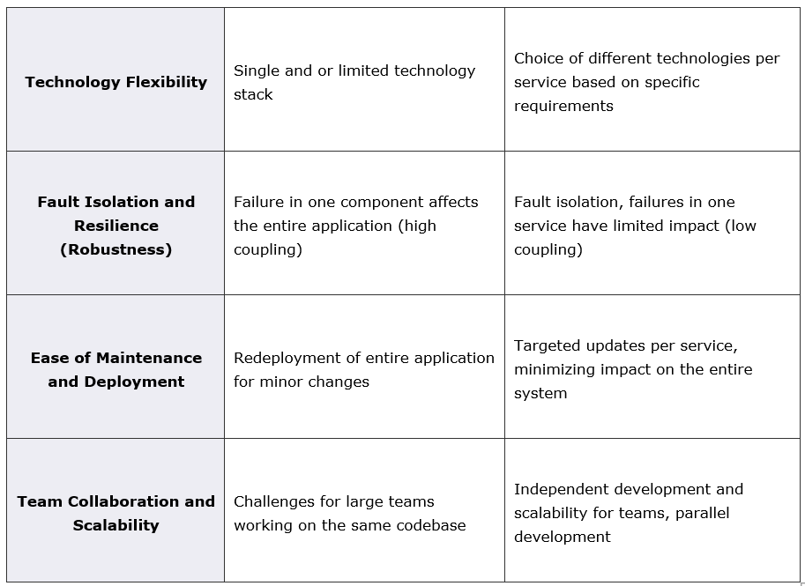

Slide 37
Network Architecture
Cabling (Cat 5e/Fiber) (Layer 1)
Switches (Layer 2)
Routers (Layer 3)
Network Topology
Physical
Logical (Subnets)
Ring, Mesh, etc
Firewalls (i.e. filtering, port forwarding)
Load Balancers
Applications (Layer 7)

Slide 38
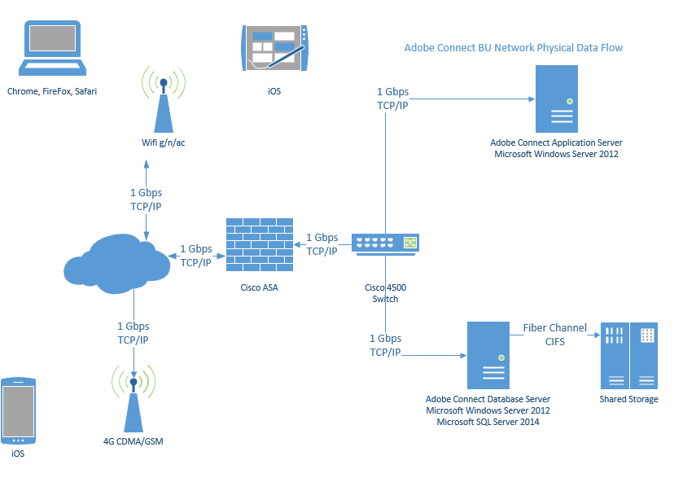
Network Architecture DFD
A physical DFD that allocates processors (clients and servers) and devices (machines and robots) to a network (Whitten, 2007)

Slide 39
Final Thoughts on DFDs
Data Flow Diagrams good for identifying and describing processes
Not good at showing logic inside processes
DFDs show the flow of data through a system
Activity Diagrams (flowcharts) show the flow of control sequence and transfer of control
How to do it?
Flowcharts & Activity Diagrams –C (Customer) Level
Pseudocode – D (Developer) Level

Slide 40
References
Braude, E. (2014). Module 5 Metropolitan College, Boston University, Boston, MA.
Whitten, B. (2007). Systems analysis & design methods. (7th ed.). New York, NY: McGraw-Hill Irwin.
Fowler, M. (2018) Located in Module 5, MET, Boston University, Boston, MA.

